Slide 1



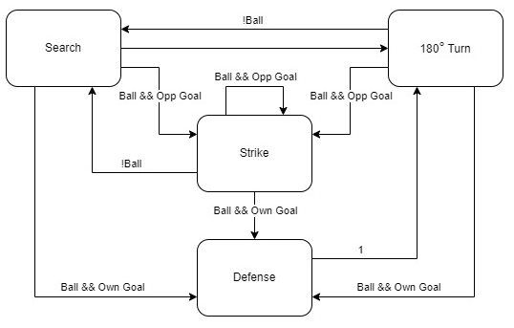
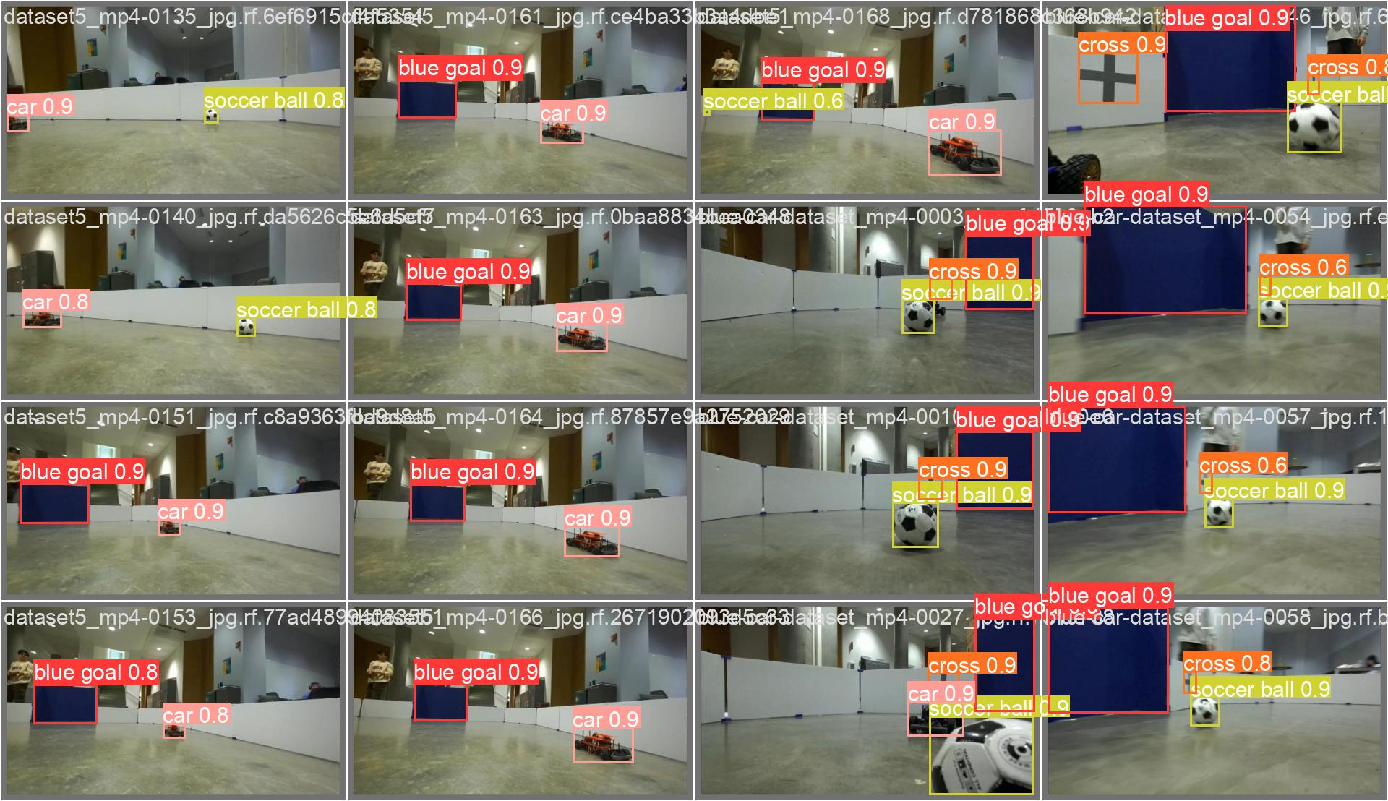

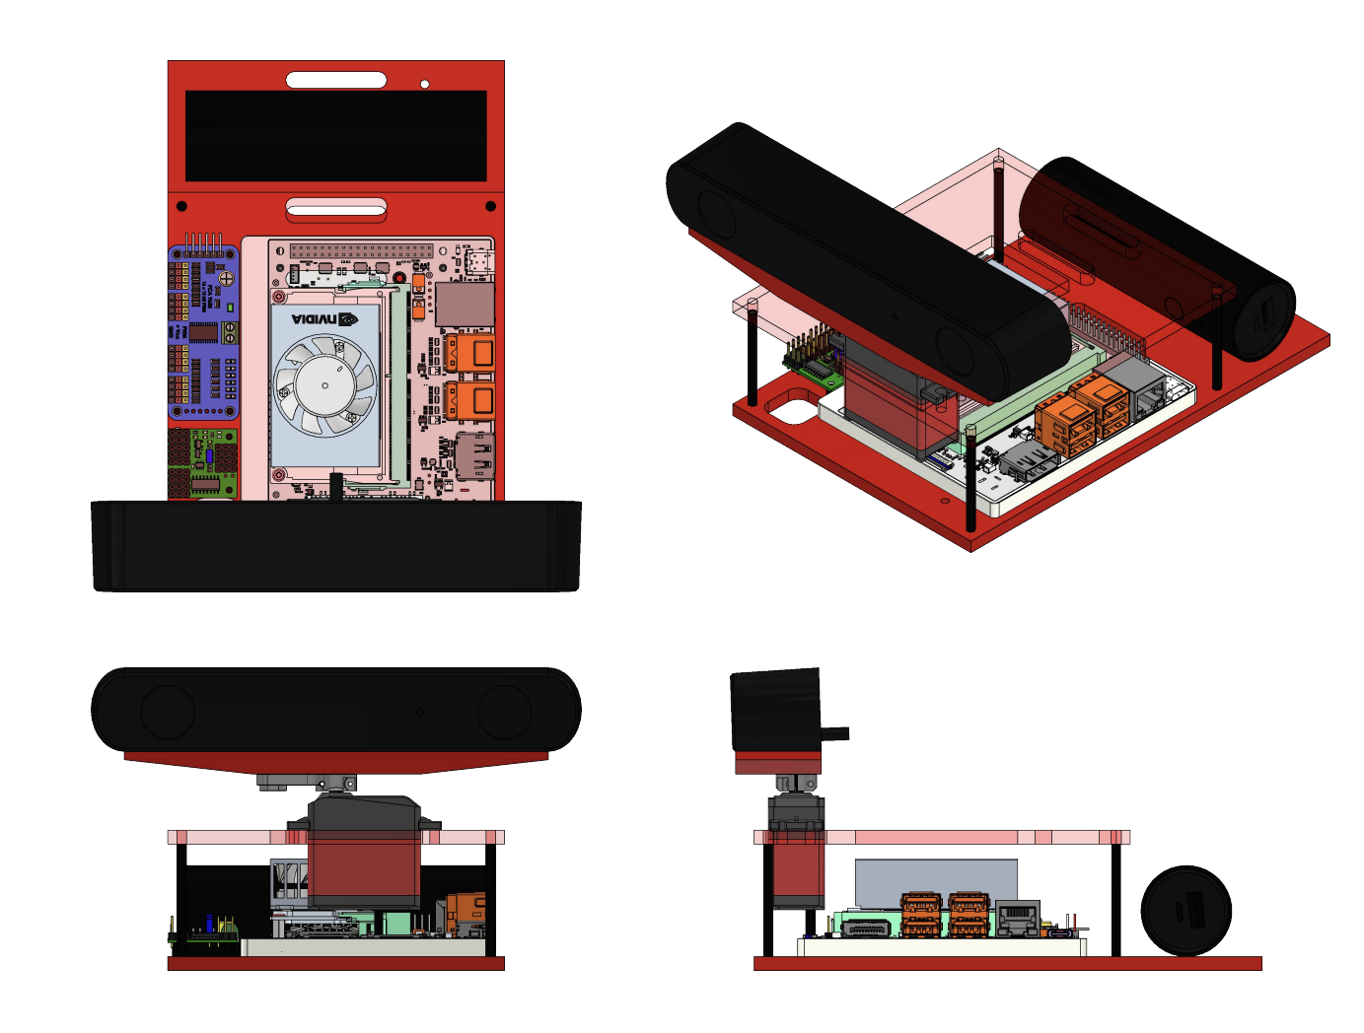

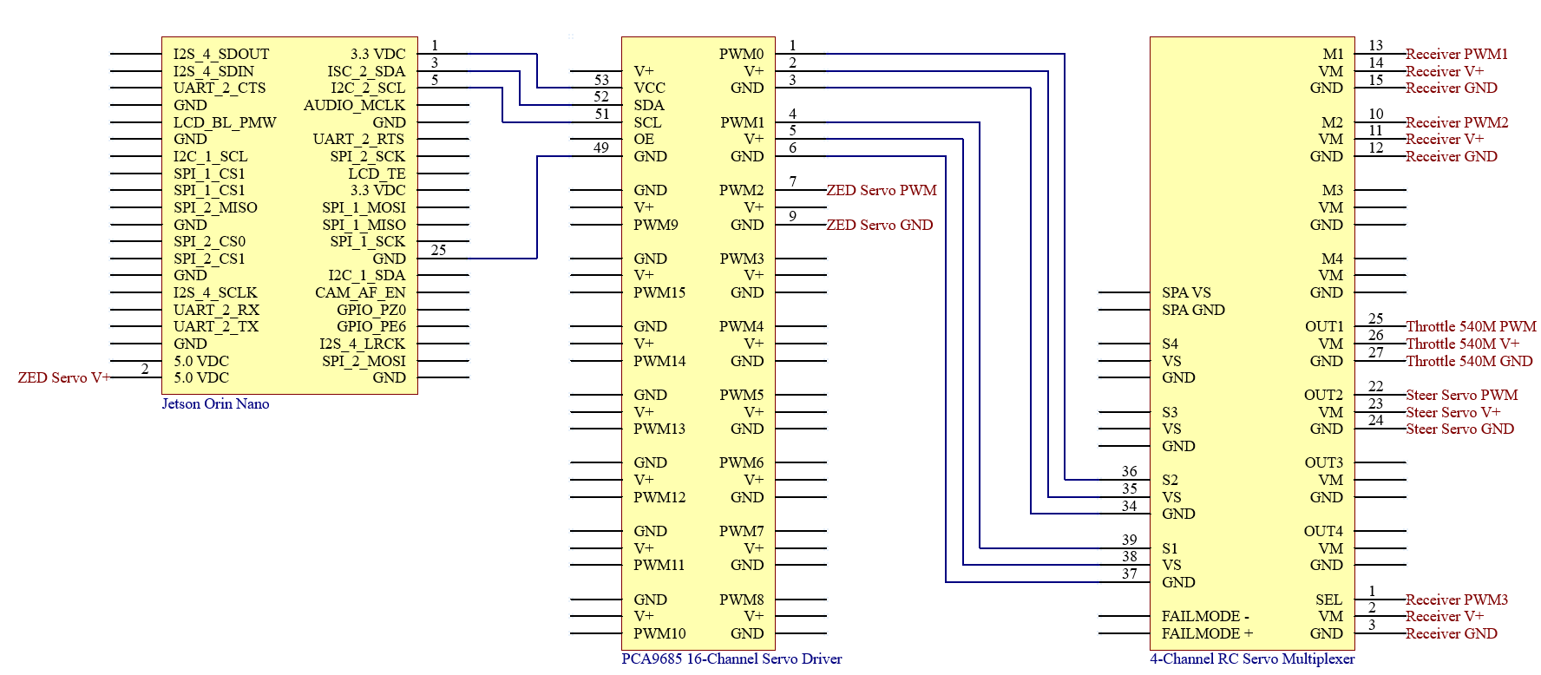
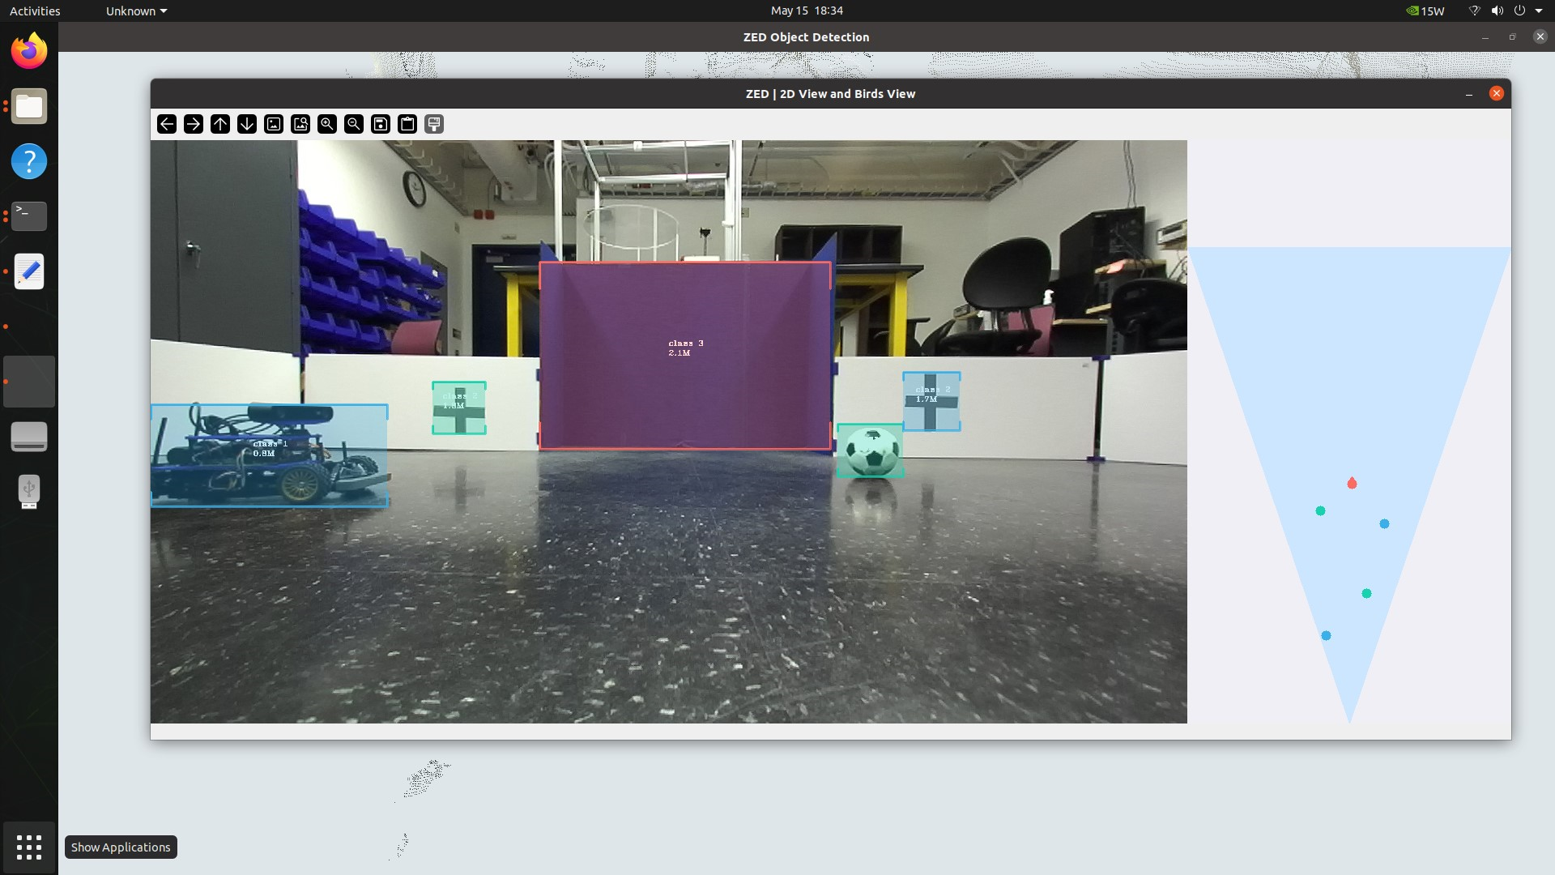
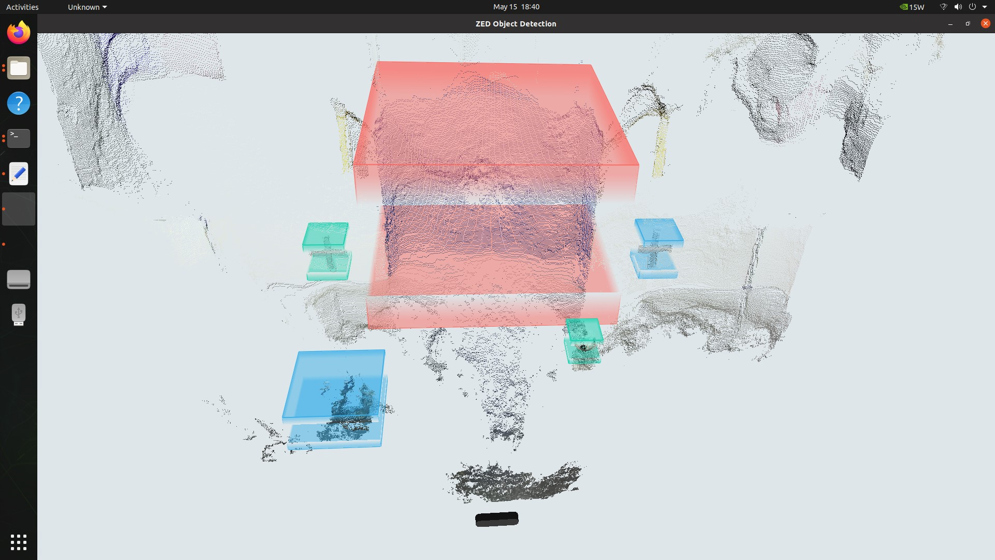
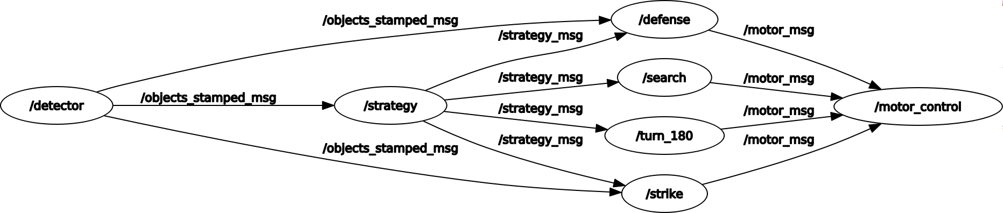
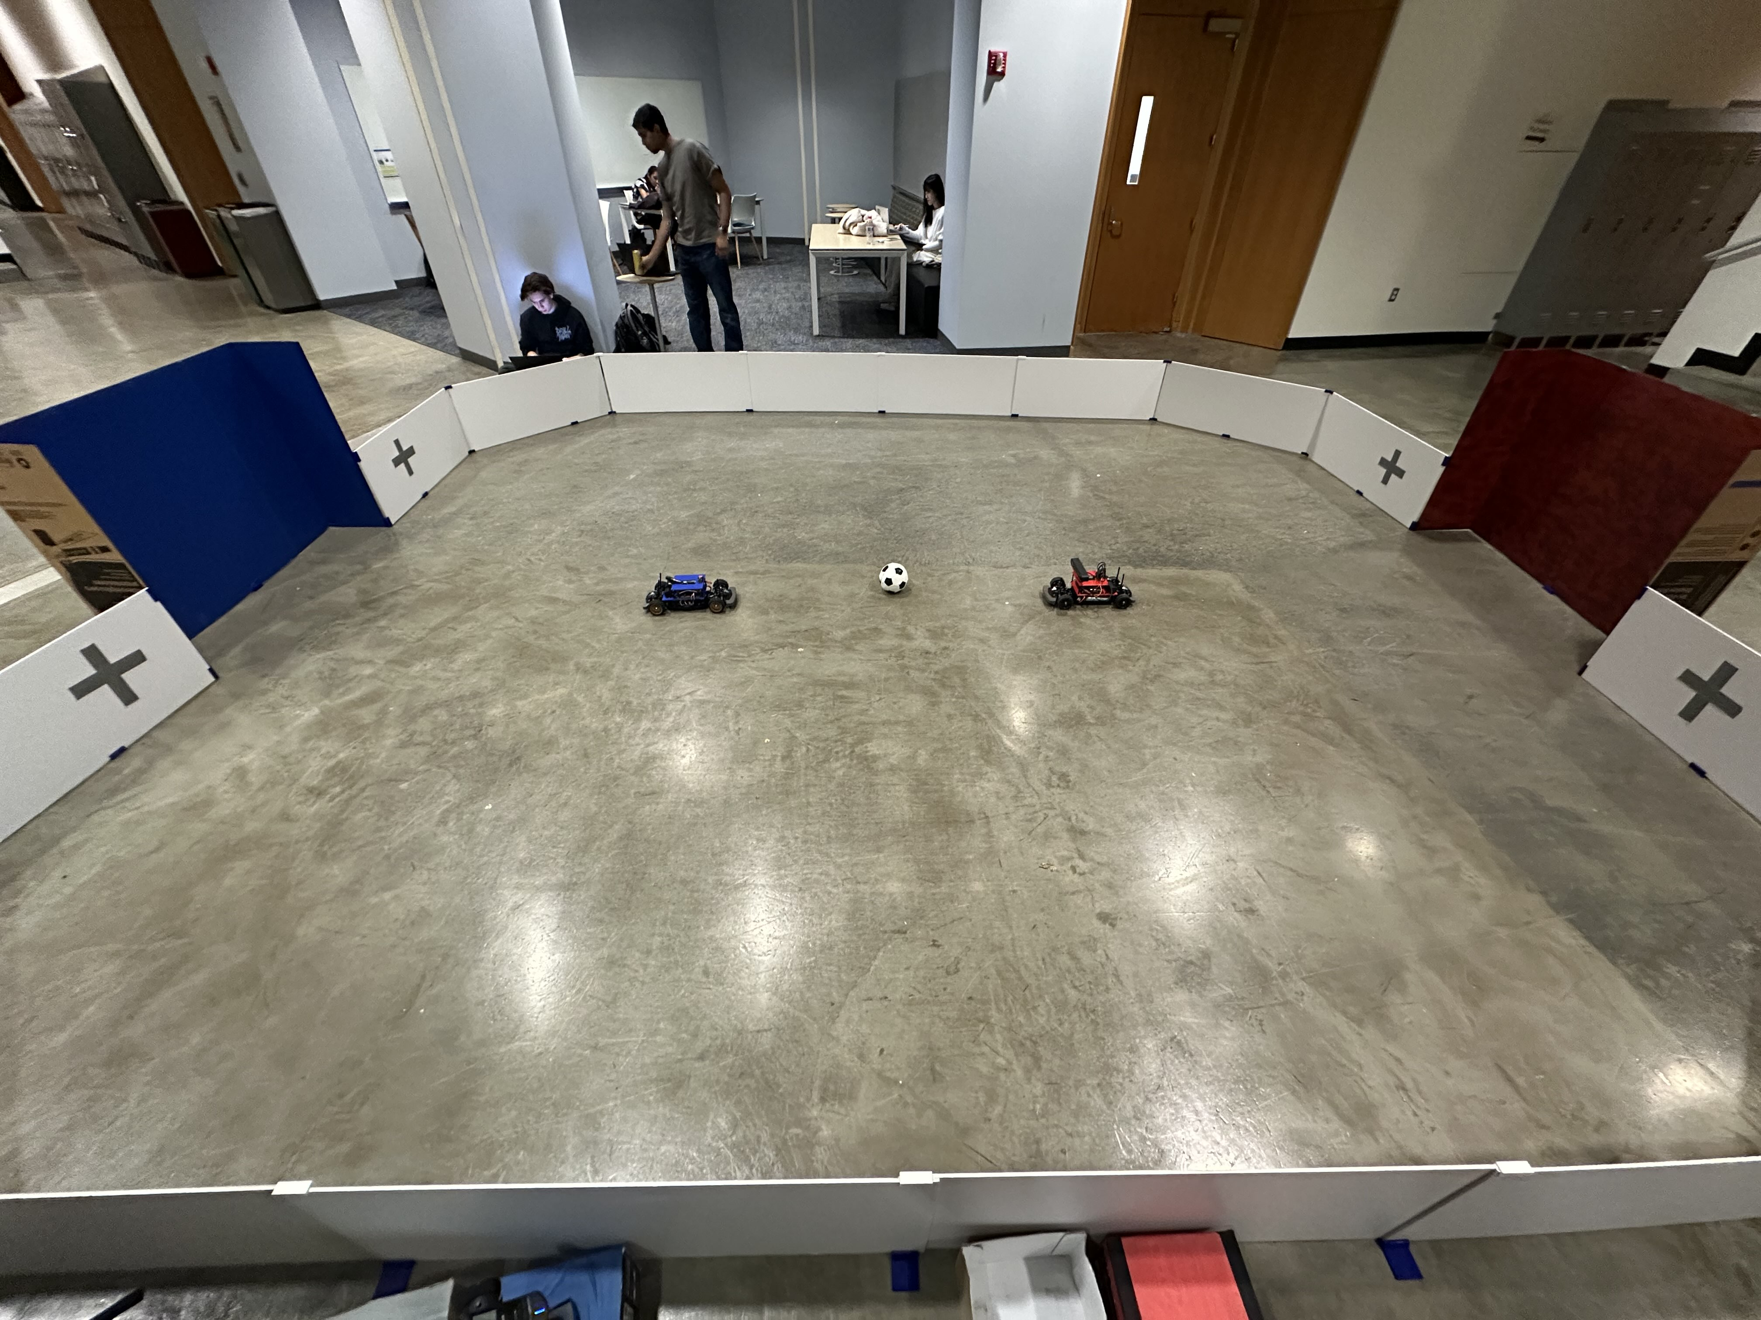
JETRACER SOCCER LEAGUE
STUDENTS: JAROD MARSHEL, ARJUN SIMHA, K GUPTA, COOPER RITTER,
CASEY RITTENHOUSE, JULIE HAM, MASON KANG
Objectives
Object Detection
Soccer Strategy
Construct JetRacer cars to compete in autonomous 2v2 soccer.
Incorporate a new sensor suite to enhance car capabilities and situational awareness.
Demonstrate the ability to score goals by dribbling and striking the ball in a controlled trajectory.
Enable cooperation with allies to score goals and oppose foes trying to score.
Roboflow computer vision software used to create image dataset.
Annotated over 1000 images of cars, ball, goals, and crosses for dataset.
YOLO object detection algorithm allows for smooth integration with ZED2 and ROS.
Utilized YOLOv8 model to improve both detection accuracy and inference speed.
Increased confidence rates of object detection by +20% compared to last year.
Achieves 30 FPS detection for 720p HD video stream.
The Strategy node allows for simple node switching based on the environmental situation.
The FSM within the Strategy node transitions states based on detected objects and position, triggering or stopping individual movement nodes.
Each movement node uses CV information to determine proper trajectory and speed.
JetRacer Hardware
blue goal
85
1
160
Jetson Orin Nano Developer Kit
8 GB DDR5
40 TOPS
1.5GHz
ZED2 Stereo AI Camera
120° Wide-Angle FOV
Neural Depth/Spatial Object Sensing
Built-in IMU
Tamiya TT-02 RC Chassis Kit
Mabuchi RS-540 Brushed Motor
Futaba S3004 Servo
7V 3000mAh NiCd Battery Pack
RS304 Receiver
T3PV FM Controller
PCA9685 Adafruit 16-Channel I2C Servo Driver
Pololu 4-Channel RC Servo Multiplexer
Miuzei 25kg High Torque Servo
Anker Nano 10,000mAh Portable Charger
car
1
154
8
140
123
2
120
Fig 9. Strategy Finite State Machine
cross
100
1
3
80
Results
Predicted
89
red goal
176
5
60
ball
40
Demonstrated working 1v1 soccer with autonomous JetRacer agents.
Improved sensor suite with ZED2 AI stereo camera.
Enhanced object detection confidence using a new dataset.
Implemented depth sensing and positional tracking.
Increased perception capabilities using a swiveling servo camera mount.
Created a more robust control strategy using a custom ROS Noetic package.
Strategy FSM for offense and defense node switching.
Flexible structure optimized for smooth future integrations.
Upgraded JetRacer car hardware and mounts.
Constructed a new soccer field.
Provided detailed documentation for future years.
1
3
1
20
background
cross
red goal
background
0
blue goal
car
ball
Github Repository:
Fig 4. Object Detection Validation Dataset
True
Fig 1. Hardware CAD
Fig 5. Confusion Matrix of Test Data
Depth Sensing & Positional Tracking
Overlays detected objects bounding boxes over 3D point cloud for accurate object depth estimation and positional tracking.
Achieves a median error of 0.914% for depth measurements less than 5m.
Fig 2. Wiring Diagram
ROS Integration
Future Work & References
Streamlined communication between distinct hardware and software processes using a ROS Noetic environment.
The top-level JetRacer package uses the ZED2 ROS wrapper for object detection to determine strategy.
Fig 7. 3D Point Cloud of Detected Objects
Future Work:
Purchase hardware to construct additional cars.
Utilize more ZED2 built-in capabilities.
Improve strategy to include more environmental scenarios.
Decrease object detection latency.
Implement additional sensors, such as motor encoders, to supplement ZED2 IMU.
Develop reinforcement learning in a simulation environment to train agents.
References:
[1] “NVIDIA-AI-IOT/jetracer,” GitHub, Apr. 23, 2021. https://github.com/NVIDIA-AI-
IOT/jetracer (accessed May 17, 2024).
[2] B. L. M. de Oliveira, “bryanoliveira/soccer-twos-env,” GitHub, Apr. 12, 2024.
https://github.com/bryanoliveira/soccer-twos-env (accessed May 17, 2024).
Fig 6. Positional Tracking
Field Design
Constructed a brand new 20' x 15' soccer arena.
Red and blue colored goals for object detection.
Assembled using 3D printed brackets and foam board.
Included cross symbols on the walls to assist with offensive and defensive soccer strategy.
Match played with a size 1.5 black and white soccer ball.
Fig 3. JetRacer Package RQT Visualization
Fig 8. JetRacer Soccer Field
ADVISERS: Dalton Smith, Pete Sulcs, James Waltner, Prof. John Raiti, Amisha Somaiya
Notes:
Horizontal Version

